Slide 1
Book2
File created on: 10/7/2021 11:06:47 AM

Slide 2
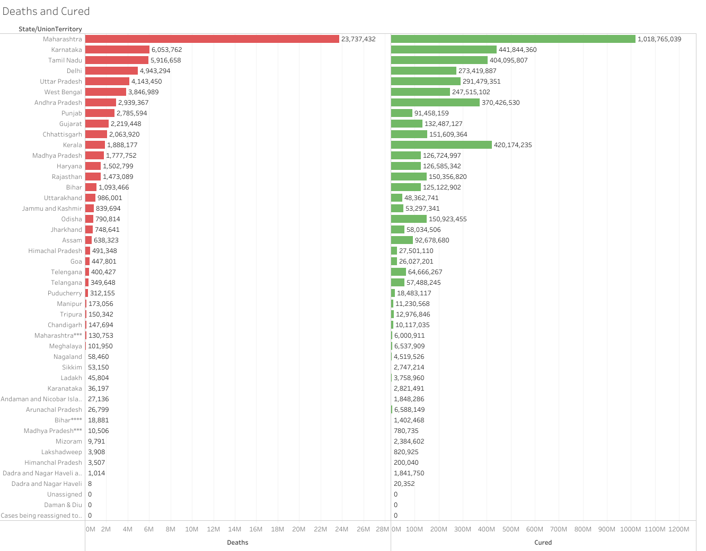

Slide 3
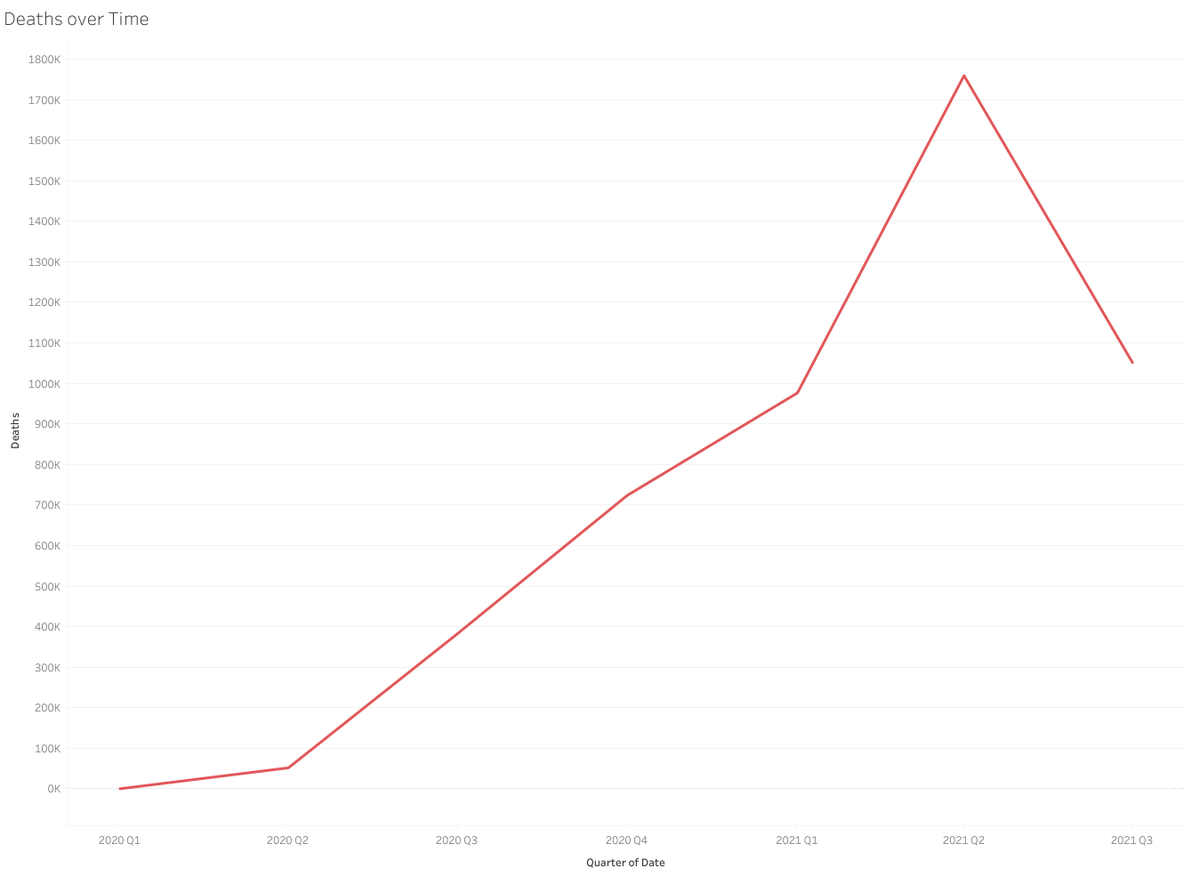

Slide 4
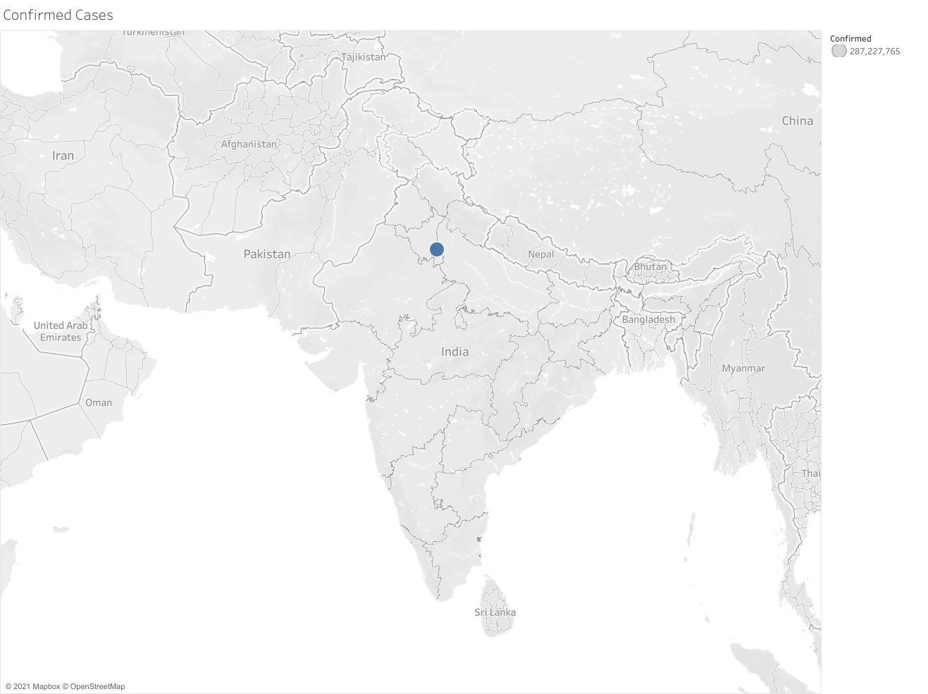

Slide 5
